Slide 1


Slide 2
About Today…
Sequelize
Database Interaction

Slide 3
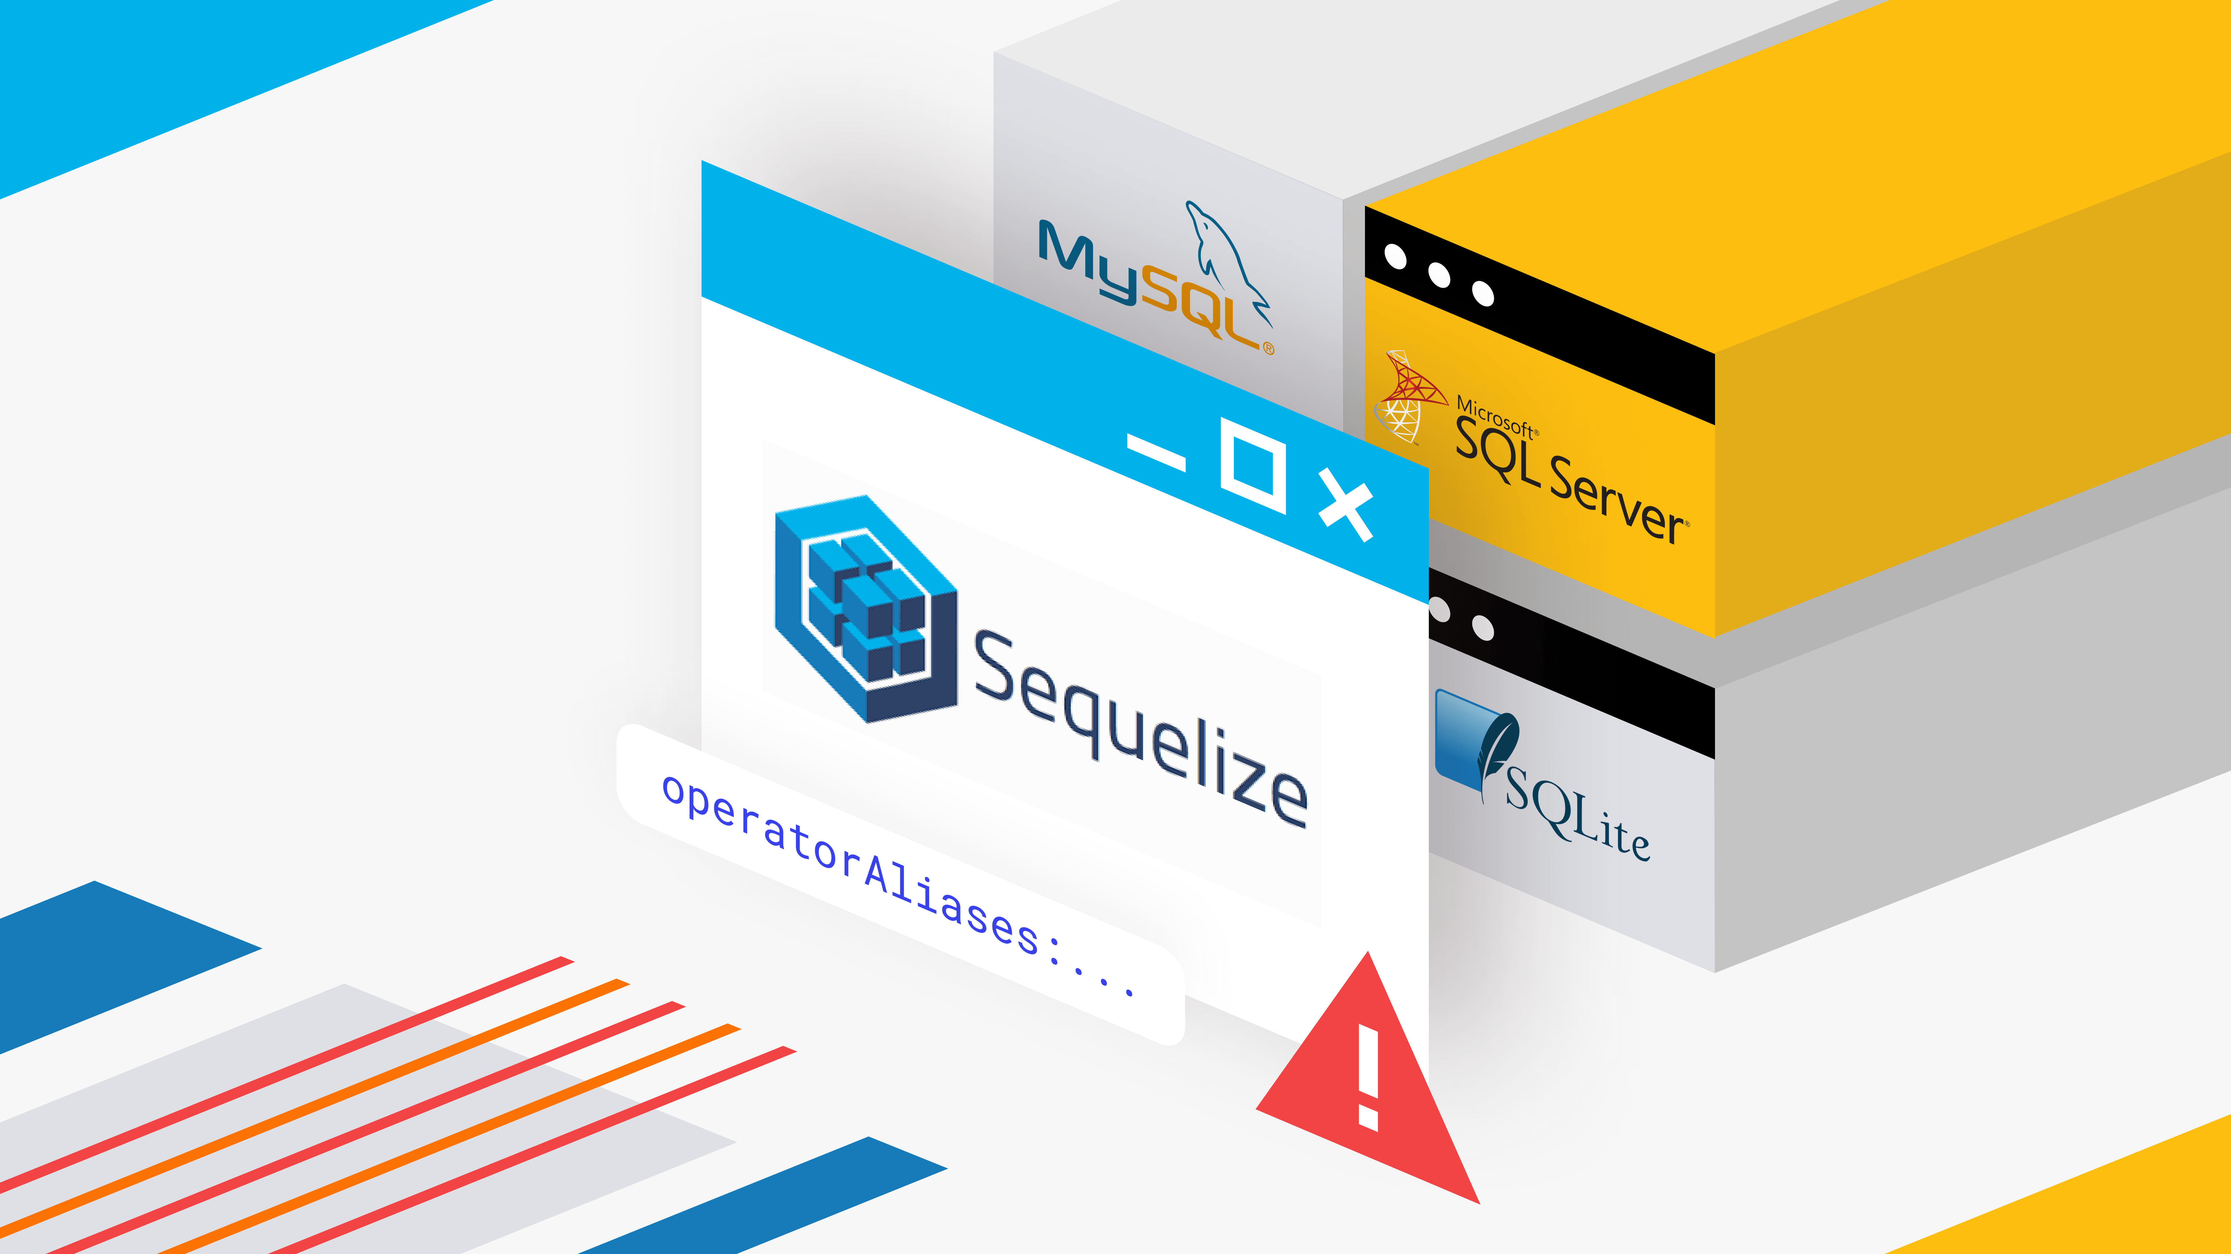

Slide 4

Intro to Sequelize
Definition
A promise-based Node.js ORM for Postgres, MySQL, MariaDB, SQLite, and Microsoft SQL Server
Benefits
Simplifies database interaction
Reduces SQL complexity
Basic Syntax
Easy-to-use syntax
Data validation and manipulation
Database synchronization

Slide 5
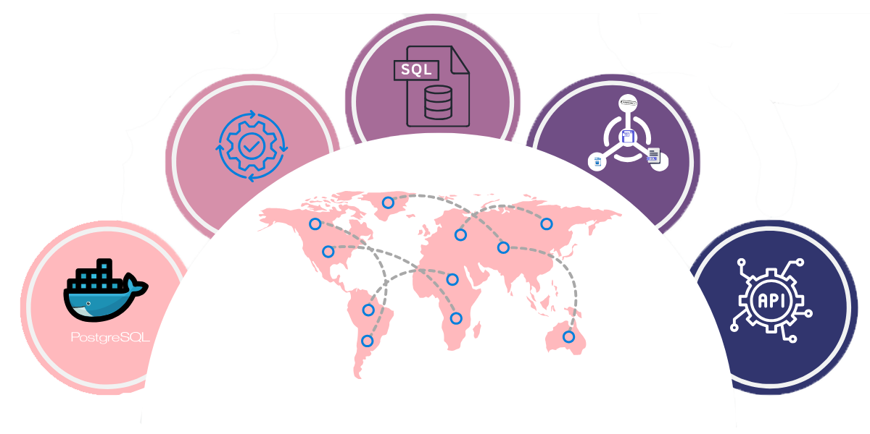
Setting Up Sequelize
Prerequisites
Node.js and npm installed
Database server running (e.g., PostgreSQL)
Installing Sequelize and Sequelize CLI
npm install sequelize sequelize-cli
Installing a database driver (example for PostgreSQL)
npm install pg pg-hstore

Slide 6
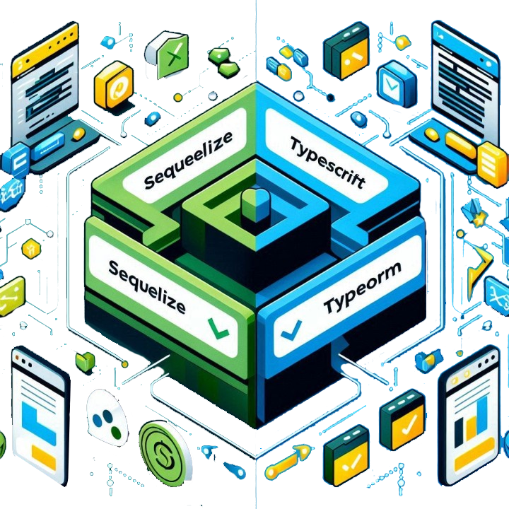
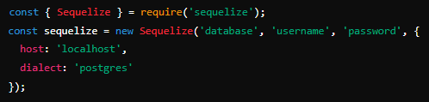
Initializing Sequelize
Setting up a new project
Initialize a new Node.js project:
npm init -y
Creating a Sequelize instance

Slide 7

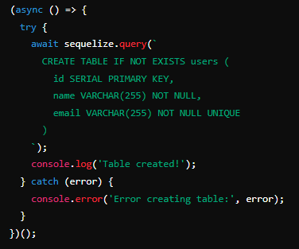
Executing Raw Queries
Running raw SQL queries using Sequelize

Slide 8
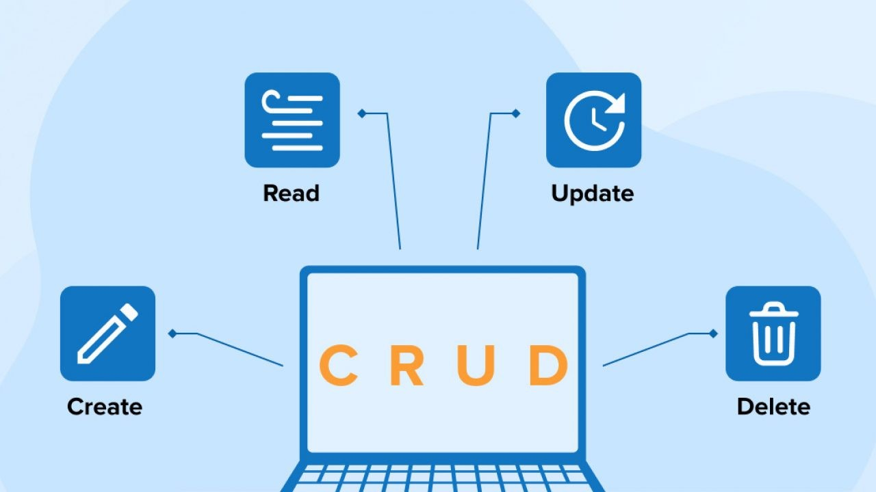

Slide 9

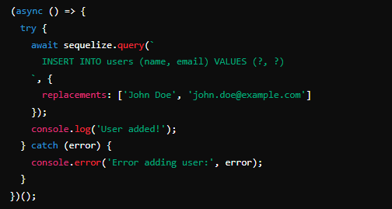
Create
Adding new records using raw queries

Slide 10
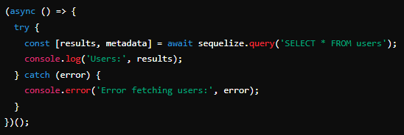

Read
Querying records using raw queries

Slide 11
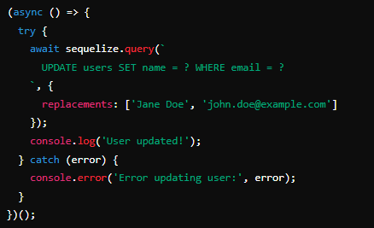

Update
Modifying existing records using raw queries

Slide 12
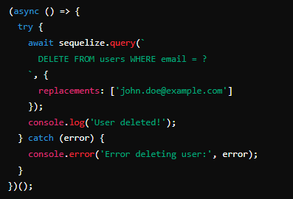

Delete
Removing records using raw queries

Slide 13

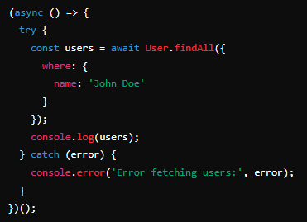
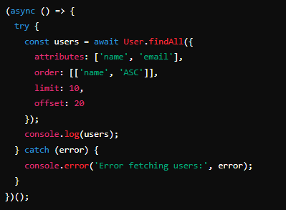
Querying with Sequelize
Basic querying methods
findAll(), findOne(), findByPk()
Filtering data with where clause
Advanced querying

Slide 14

What is Sequelize?
A promise-based Node.js ORM for Postgres, MySQL, MariaDB, SQLite, and Microsoft SQL Server
What is the purpose of the replacements option in a raw query execution?
The replacements option is used to safely insert values into the query, preventing SQL injection
What does sequelize.query return?
It returns an array with the first element being the query results and the second element being metadata about the query

Slide 15

Task
Create a Node.js application using Sequelize to perform basic CRUD operations on a PostgreSQL database

